Slide 1
Starter 1

Slide 2
The family next door
has both girl and boy children. Each of the boys has the same number of brothers as he has sisters AND each of the girls
has twice as many
brothers as she
has sisters.
How many boys and girls are there?

Slide 3
ANSWER:
4 boys and 3 girls.

Slide 4
Starter 2

Slide 5
How Many Triangles?

Slide 6
ANSWER
12

Slide 7
Starter 3

Slide 8

Small oranges cost 8p each, large oranges cost 13p each.
Some oranges are bought and the bill is exactly £1.00. How many of each size of oranges are bought?

Slide 9
ANSWER
Large 4
Small 6

Slide 10
Starter 4

Slide 11
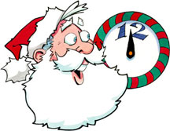
The reflection of a clock shows 3.55, what time is it really?

Slide 12
ANSWER
8.05

Slide 13
Starter 5

Slide 14
The Jumping Frog
A frog has fallen into a pit that is 30m deep.
Each day the frog climbs 3m, but falls back 2m at night.
How many days does it take for him to escape??

Slide 15
A N S W E R
28 days
After 27 days and nights the frog has only 3 metres to go. On the 28th day the frog is able to jump clear.

Slide 16
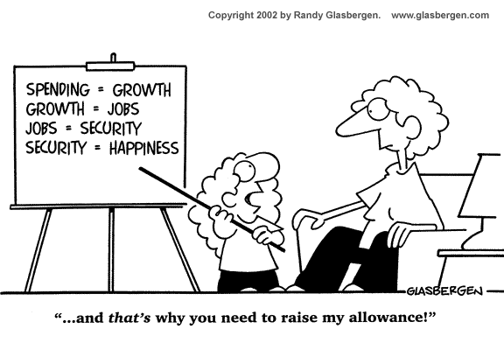

Slide 17
Starter 6

Slide 18
113°
x°
37°
How big is angle x ?
A: 76°
B: 104 °
C: 113 °
D: 114 °
E: 150 °

Slide 19
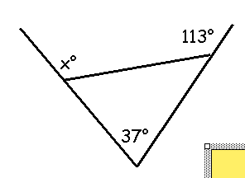
ANSWER : B
A: 76°
B: 104 °
C: 113 °
D: 114 °
E: 150 °

Slide 20
Starter 7

Slide 21
This sentence contains the letter e times.
Seven Eight Nine Ten Eleven
Which of the five words above can be placed in the gap to make the sentence true?

Slide 22
ANSWER: Nine & Eleven
This sentence contains the letter e times.

Slide 23
Starter 8

Slide 24

At the end of hard day at the mine, the seven dwarfs share out all their golden nuggets, making sure that they each get the same number of nuggets. If there are any left over, they are given to Snow White.
Which number of nuggets would leave Snow White with the most?
A: 300 B: 400 C: 500 D: 600 E:700

Slide 25
ANSWER
A

Slide 26
Starter 9

Slide 27
WHICH LETTER DOES NOT OCCUR MORE THAN ONCE IN THIS QUESTION – INCLUDING THE FIVE OPTIONS?
A B C D E

Slide 28
WHICH LETTER DOES NOT OCCUR MORE THAN ONCE IN THIS QUESTION – INCLUDING THE FIVE OPTIONS?
A B C D E
ANSWER

Slide 29
Starter 10

Slide 30
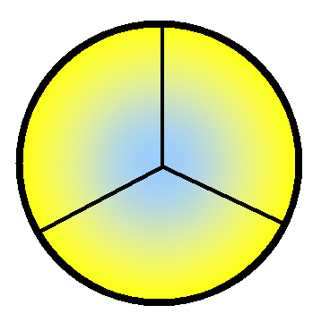
7
8
9
3
5
4
7
2
?
?

Slide 31
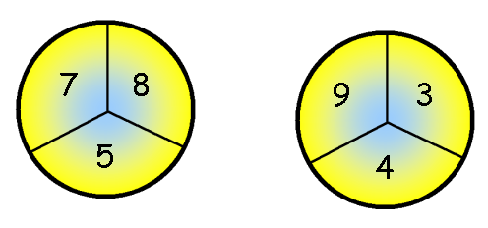
ANSWER
(7 + 2) ÷ 3
7
2
3

Slide 32
Starter 11

Slide 33
The supermarket has a special offer on tins of cat food – buy 5 get one free.
10 tins cost £4.32.
What would 20 tins cost?

Slide 34
ANSWER
£8.16

Slide 35
Starter 12

Slide 36
35°
A: 75
B: 85
C: 95
D: 105
E: 115
15°
x°
25°
What is the value of x?

Slide 37
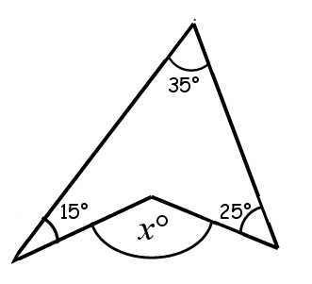
What is the value of x?
ANSWER: A: 75
Interior angles in a
quadrilateral add up to 360°
360-(35 + 15 + 25) = 285
X = 360 – 285
X = 75
A: 75
B: 85
C: 95
D: 105
E: 115

Slide 38
Starter 13

Slide 39
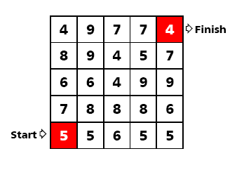
Start at the bottom left square and move up,
down, left or right until you reach the reach.
Add the number as you go.
Can you make exactly 53?

Slide 40
A N S W E R

Slide 41
Starter 14

Slide 42
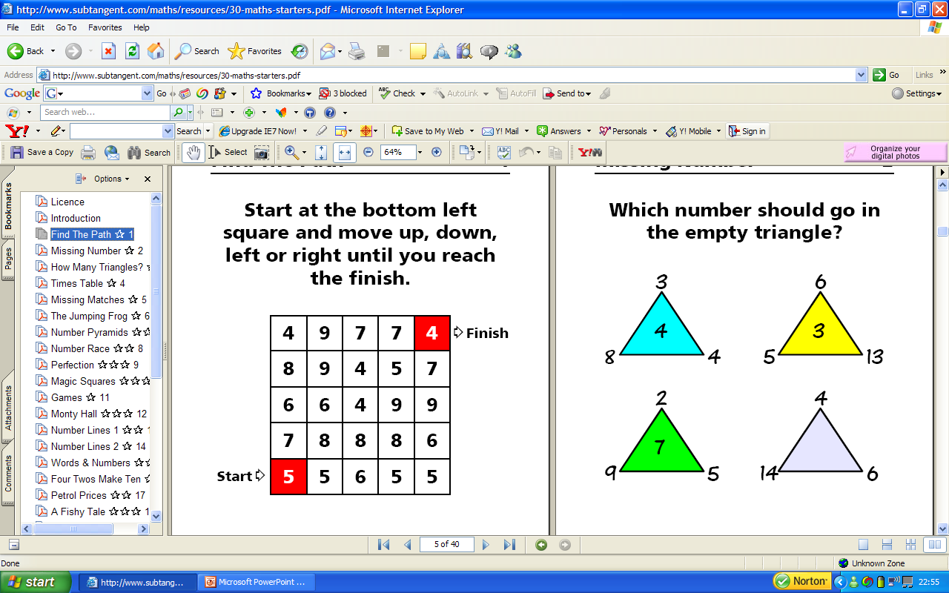
Missing Number
Which number should go in the
empty triangle?

Slide 43
5
(14 + 6) ÷ 4

Slide 44
Starter 15

Slide 45
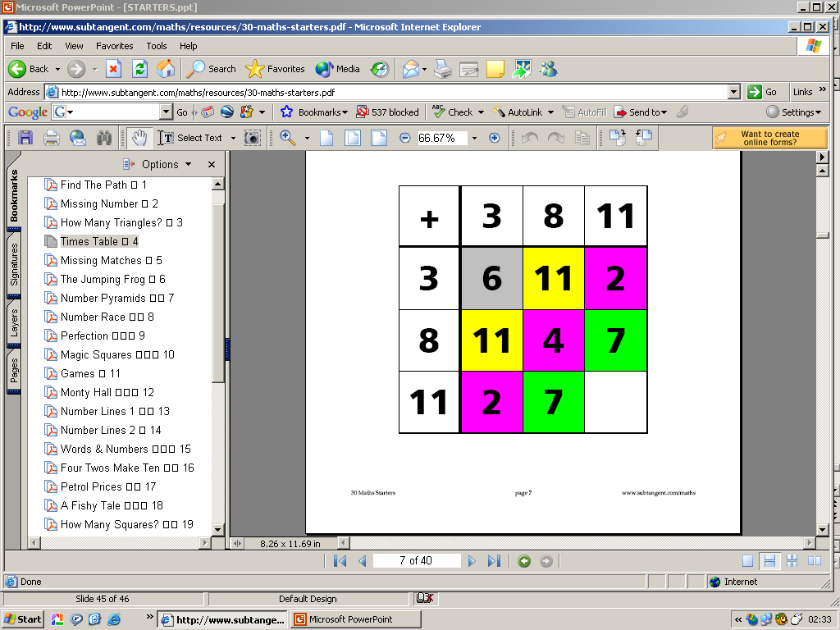
There is something strange about this addition square.
Can you work out what the missing number is?

Slide 46
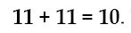
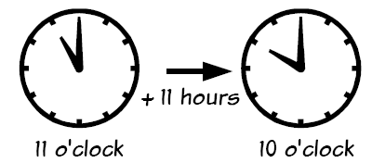
ANSWER

Slide 47
Starter 16

Slide 48
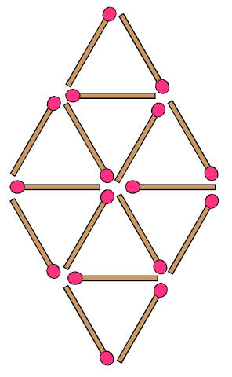
M i s s i n g M a t c h e s
Remove just 4 matches
to leave 4 equivalent
triangles – they must be
all the same size.

Slide 49
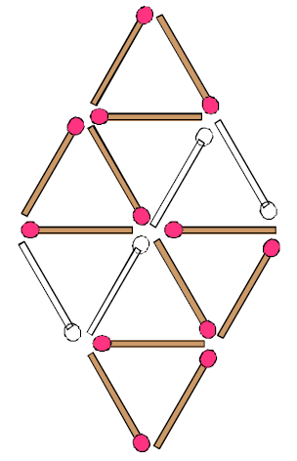
A N S W E R

Slide 50
Starter 17

Slide 51
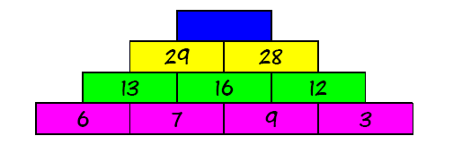
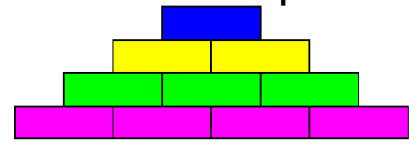
Can you work what the number will
be at the top of the pyramid?
Can you make a pyramid with 100 at the top?

Slide 52
ANSWER
57

Slide 53
Starter 18

Slide 54
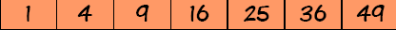
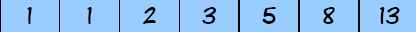
Here are the first few SQUARE numbers…….
Here are the first few FIBONACCI numbers…….
The square numbers are well in the lead. Do the Fibonacci numbers ever catch up?

Slide 55
ANSWER
The 12th square and Fibonacci numbers are both 144.
After this Fibonacci are in the lead.

Slide 56
Starter 19

Slide 57
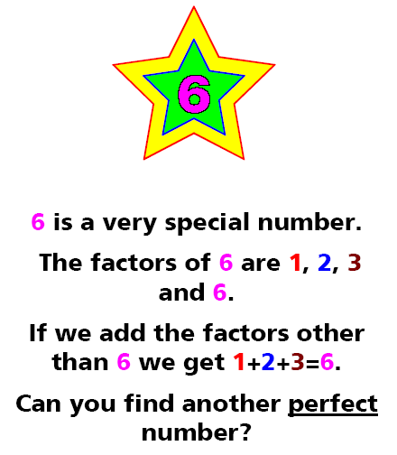
PERFECT NUMBER

Slide 58
ANSWER
28 = 1 + 2 + 4 + 7 + 14.

Slide 59
Starter 20

Slide 60
MAGIC SQUARE
Can you put the digits 1 to 9
in a square so that every row,
column and diagonal add to 15?

Slide 61
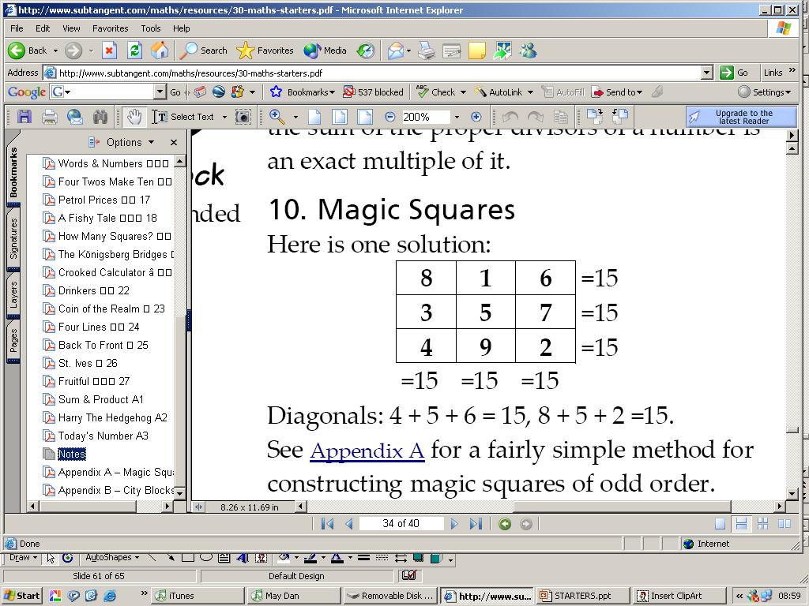
ANSWER

Slide 62
Starter 21

Slide 63
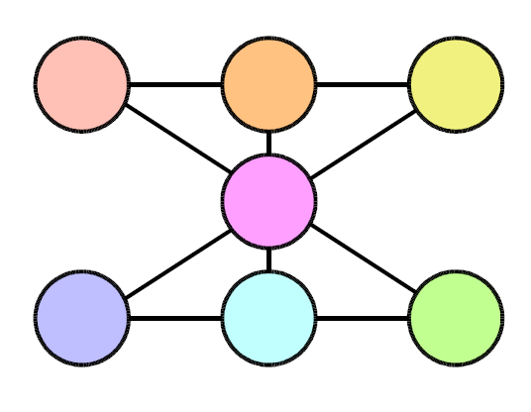
NUMBER LINES
Can you put the numbers 1 to 7 in each circle
so that the total of every line is 12.

Slide 64
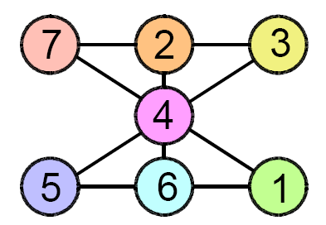
ANSWER

Slide 65
Starter 22

Slide 66
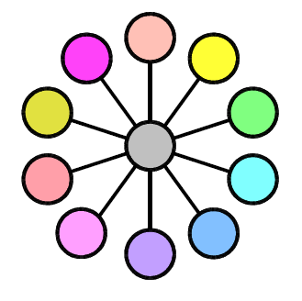
NUMBER LINES
Can you put the digits 1 to 11 in each circle
so that every line has the same total?

Slide 67
ANSWER
7
8
1
9
2
6
10
3
11
4
5

Slide 68
Starter 23

Slide 69
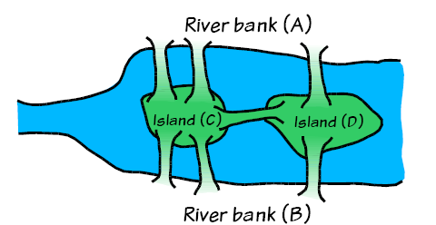
The city of Königsberg had seven
bridges that’s crossed the river Pregel.
Can you find a way of crossing all the bridges
exactly once? (you cannot go over the bridge
More than once.)
The Königsberg Bridges

Slide 70
Every time we enter a piece of land we must leave
it by a different bridge.
So there must be an even number of bridges
attached to each piece of land.
The islands have an odd number of bridges, thus
is NOT POSSIBLE!
ANSWER

Slide 71
Starter 24

Slide 72
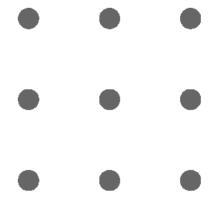
FOUR LINES
Put 9 dots in a square like this….
Can you go through all 9 dots with four straight
lines?
(you can’t take the pen off the paper)

Slide 73
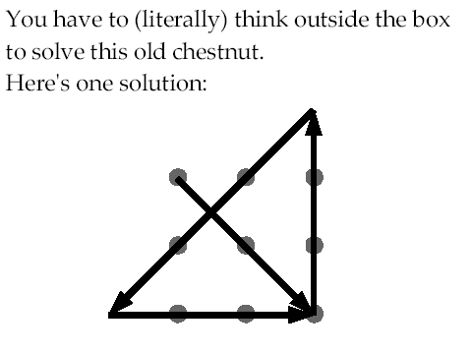
ANSWER

Slide 74
Starter 25

Slide 75
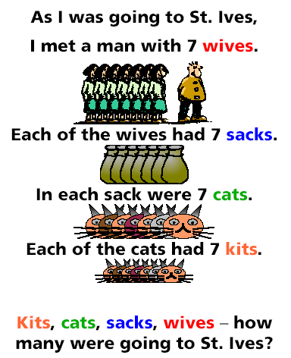

Slide 76
ANSWER
A trick question. Since you met
the man on the way to St.Ives,
he and his entourage must
be coming from St Ives. So
the answer is just
one - YOU.

Slide 77
Starter 26

Slide 78
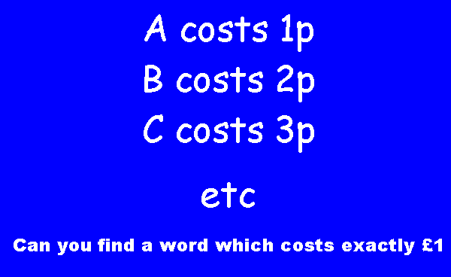
Question
£

Slide 79
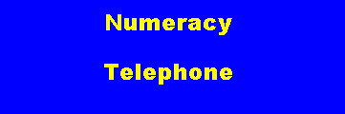
ANSWER
£

Slide 80
Starter 27

Slide 81
Which of the following expressions
gives the largest number?
A: 1 x 9 + 9 x 7
B: 1 + 9 + 9 + 7
C: 1 x 9 + 9 + 7
D: 1 + 9 x 9 + 7
E: 1 + 9 + 9 x 7

Slide 82
ANSWER
D

Slide 83
Starter 28

Slide 84
Kylie the clumsy koala is all fingers
and thumbs. Like all koala bears, Kylie
has two thumbs and three fingers on
Each front paw, and one thumb and four
fingers on each rear paw. How
many thumbs do Kylie and her nine
brothers have between them?
A: 10 B: 20 C: 30 D: 40 E: 60

Slide 85
ANSWER
Kylie the clumsy koala is all fingers
and thumbs. Like all koala bears, Kylie
has two thumbs and three fingers on
Each front paw, and one thumb and four
fingers on each rear paw. How
many thumbs do Kylie and her nine
brothers have between them?
A: 10 B: 20 C: 30 D: 40 E: 60

Slide 86
Starter 29

Slide 87
Which of these numbers is not a multiple of 3?
A: 12
B: 234
C: 3456
D: 45678
E: 567890

Slide 88
ANSWER
E

Slide 89
Starter 30

Slide 90
Diophantus known as the 'father of algebra'
There remains a riddle that describes the
spans of Diophantus's life:
Diophantus's youth lasted 1/6 of his life. He had the
first Beard in the next 1/12 of his life. At the end
of the following 1/7 of his life Diophantus
got married. Five years from then his son was born.
His son lived exactly 1/2 of Diophantus's life.
Diophantus died 4 years after the death of his son.
How long did Diophantus live?

Slide 91
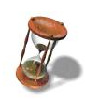
ANSWER : 84 years
SOLUTION
There is an equation to reflect the several
ages of Diophantus:
1/6x + 1/12x + 1/7x + 5 + 1/2x + 4 = x
So the solution (x) is 84 years.

