Slide 1
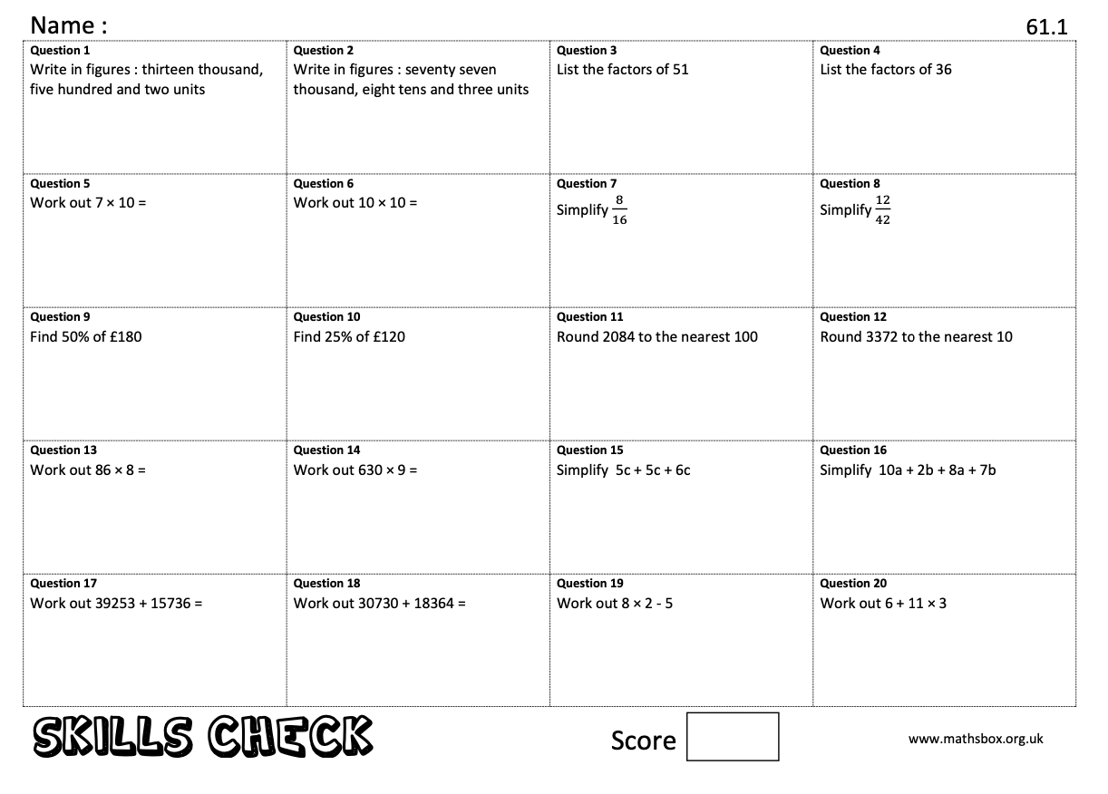
Key Skills…
When you get to a page like this, spend 10 minutes completing
the skills check questions based on topics from Y6.

Slide 2
The 24 game…
Try this with your family – who is the quickest?
One of our favourite things to do on transition is to play the 24 game. The aim of the game is to be the first person to make the number 24.
For each game you have 4 numbers, you have to use ALL four numbers, you can add, subtract, multiply or divide these to make 24.
Example:
2 2 6 8
To make 24, I can do (8 - 2) x (6 – 2)
8 -2 = 6
6 -2 = 4
6 x 4 = 24
Now it’s your turn, the 24 cards are below they get harder as you go through.
One Dot - Easiest

Slide 3
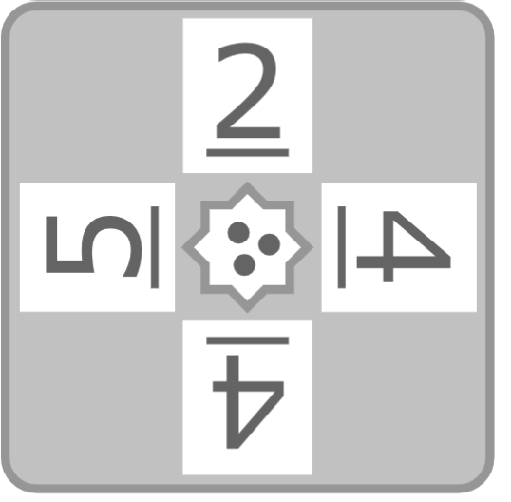
The 24 game…
two Dot - medium
three Dot - harder

Slide 4
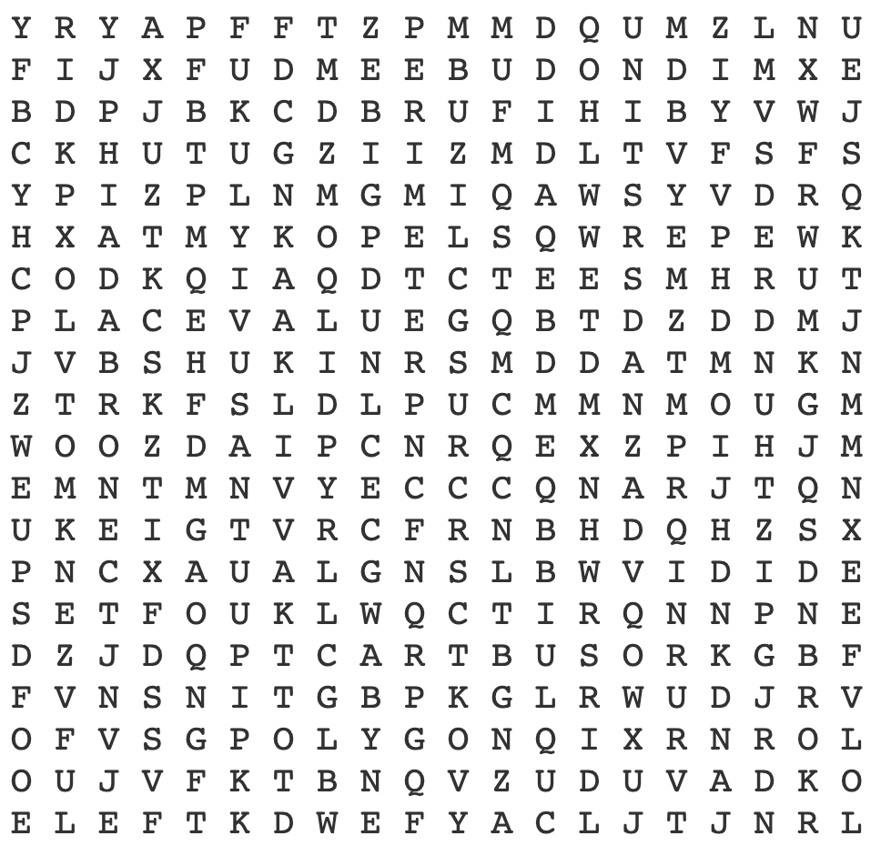
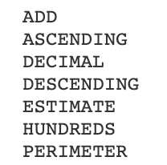
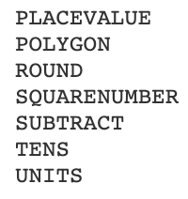
Maths Keywords…
Can you find all the keywords you will need for Year 7?

Slide 5
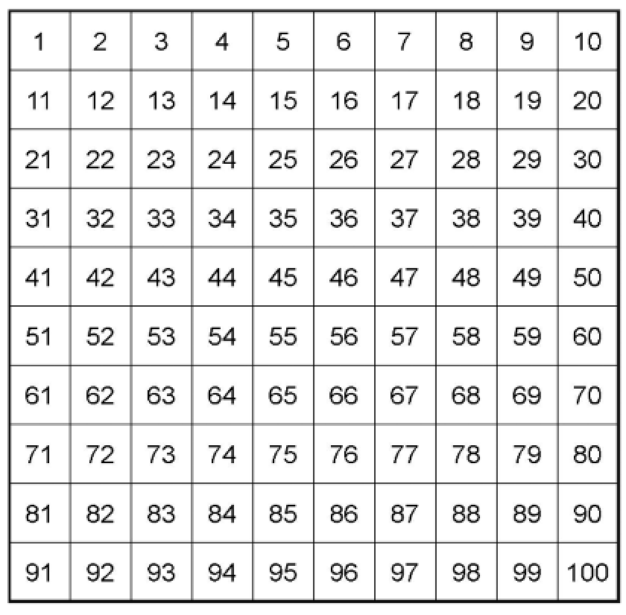
My Favourite Number
Can you work out my favourite number?

Slide 6
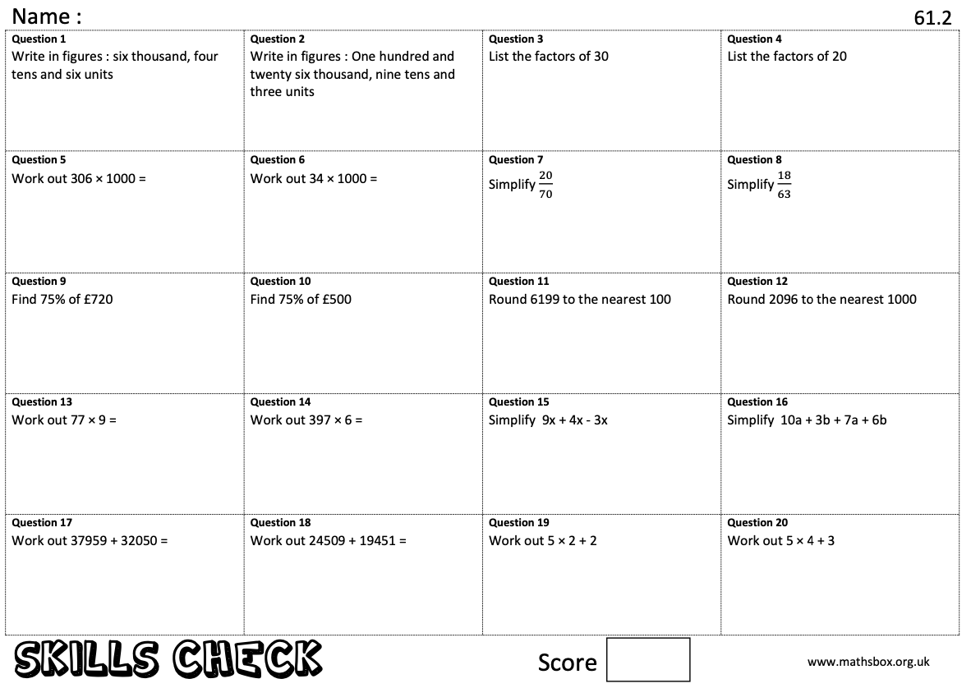
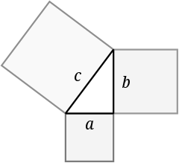
Key Skills…
When you get to a page like this, spend 10 minutes completing
the skills check questions based on topics from Y6.
Pythagoras of Samos was a famous Greek mathematician and philosopher (c. 570 – c. 495 BC). He is known best for the proof of the important Pythagorean theorem, which is about right angled triangles. He started a group of mathematicians, called the Pythagoreans, who worshiped numbers and lived like monks.
Can you find out what the Pythagorean theorem is? You will use it in Year 9.

Slide 7
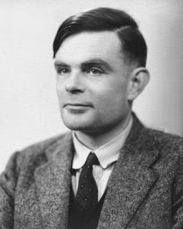
Code Breaking…
Alan Turing
Alan Turing was a British mathematician. He made major contributions to the fields of mathematics, computer science, and artificial intelligence. He worked for the British government during World War II, when he succeeded in breaking the secret code Germany used to communicate.
In September 1939 Great Britain went to war against Germany. During the war, Turing worked at the Government Code and Cypher School at Bletchley Park. Turing and others designed a code-breaking machine known as the Bombe. They used the Bombe to learn German military secrets. By early 1942 the code breakers at Bletchley Park were decoding about 39,000 messages a month. At the end of the war, Turing was made an Officer of the Most Excellent Order of the British Empire.
Can you crack the code to reveal the 2 Maths teachers who’s favourite mathematician is Turing?
A | B | C | D | E | F | G | H | I | J | K | L | M
55 | 47 | 84 | 10 | 9 | 75 | 59 | 64 | 32 | 15 | 23 | 50 | 26
N | O | P | Q | R | S | T | U | V | W | X | Y | Z
80 | 63 | 19 | 3 | 27 | 30 | 21 | 92 | 18 | 35 | 99 | 69 | 199
13 x 2 =
5 x 11 =
336 $÷$ 4 =
18 + 5 =
16 x 5 =
49 – 17 =
531 $÷$ 9 =
8² =
105 $÷$ 5 =
8 x 8 =
39 + 24 =
160 $÷$ 2 =
19 - 10 =
63 + 6 =
Can you make up some calculations to spell out your name using the same code breaker grid?
Can you make up your own message for a friend to decode?

Slide 8
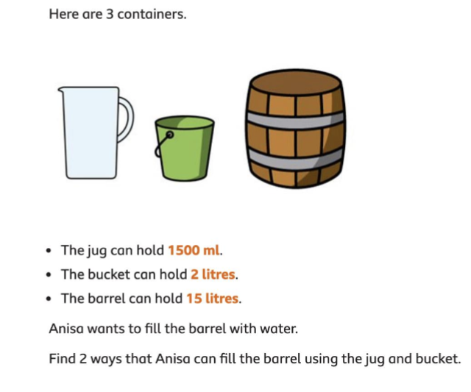
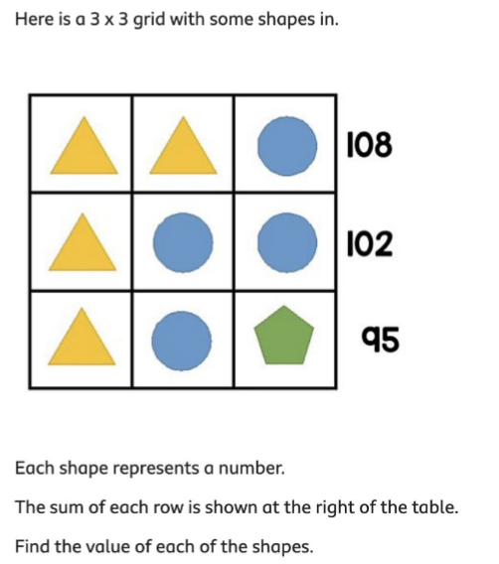
Maths Challenges…
Can you solve all the Maths challenges?
They get more difficult as you get them..

Slide 9
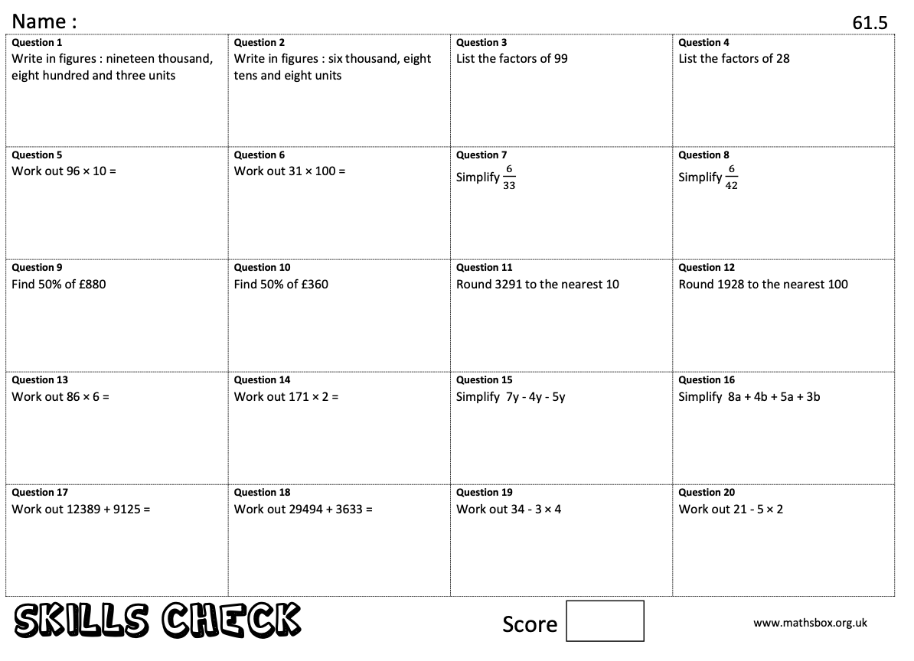
Key Skills…
When you get to a page like this, spend 10 minutes completing
the skills check questions based on topics from Y6.
René Descartes
Descartes is considered the father of modern philosophy, a key figure in the scientific revolution of the 17th Century, and a pioneer of modern mathematics. Many people also call him the father of analytic geometry, which connects the fields of algebra and geometry.

Slide 10
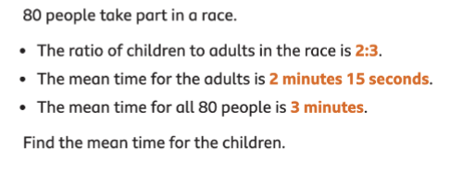
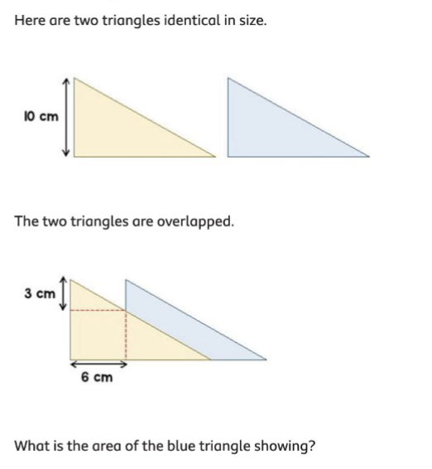
Maths Challenges…
Can you solve all the Maths challenges?
They get more difficult as you get them..

Slide 11
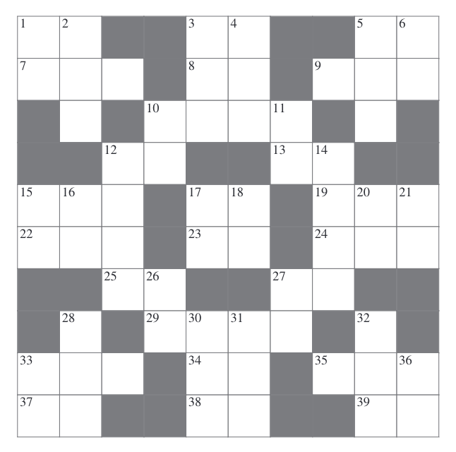
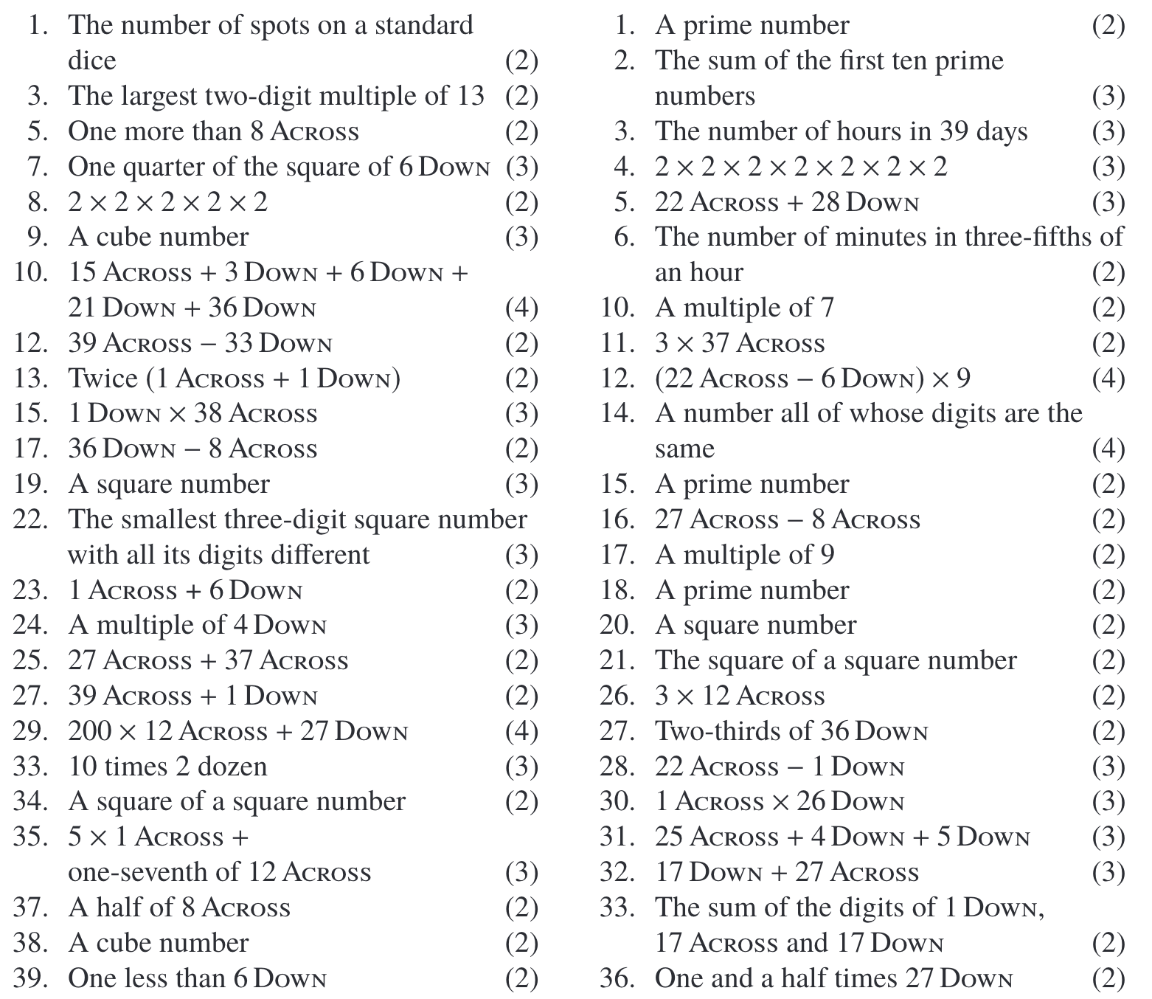
Cross Number…
Use the questions below to complete the cross number.
2
1
Across
down

